Slide 1

SciPy Integration Comparison
Numerical Computations Final Project
By Ben Burkhalter

Slide 2
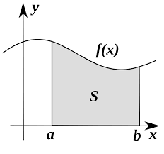
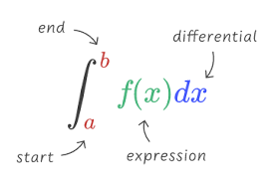
Overview
Motivation: To find which SciPy integration methods are best for certain problems and determine the accuracy and efficiency of each method.
What I Did: Tested SciPy methods: quad, fixed_quad, quadrature, romberg, trapz, cumtrapz, and simps with a myriad of different integrands and benchmarked them for their run-time and error relative to the true mathematical solution.
How: I created a Python notebook and wrote code for many different integrand functions and tested each SciPy method of integration behaved for each of these integrands. The time was benchmarked using the timeit package and the integral’s mathematical value used to compare to the absolute error was found using https://www.integral-calculator.com/ and https://www.symbolab.com/

Slide 3
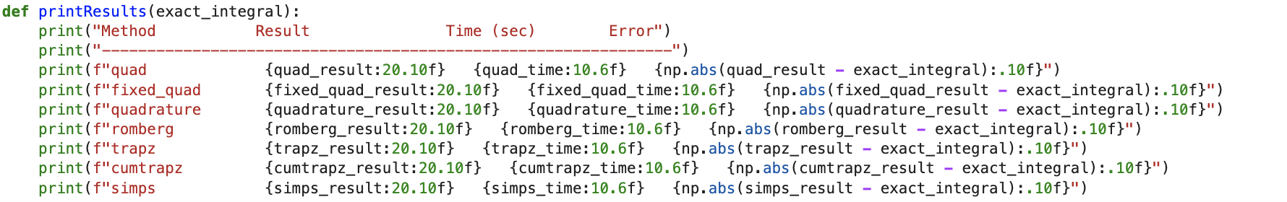
Starting Code

Slide 4
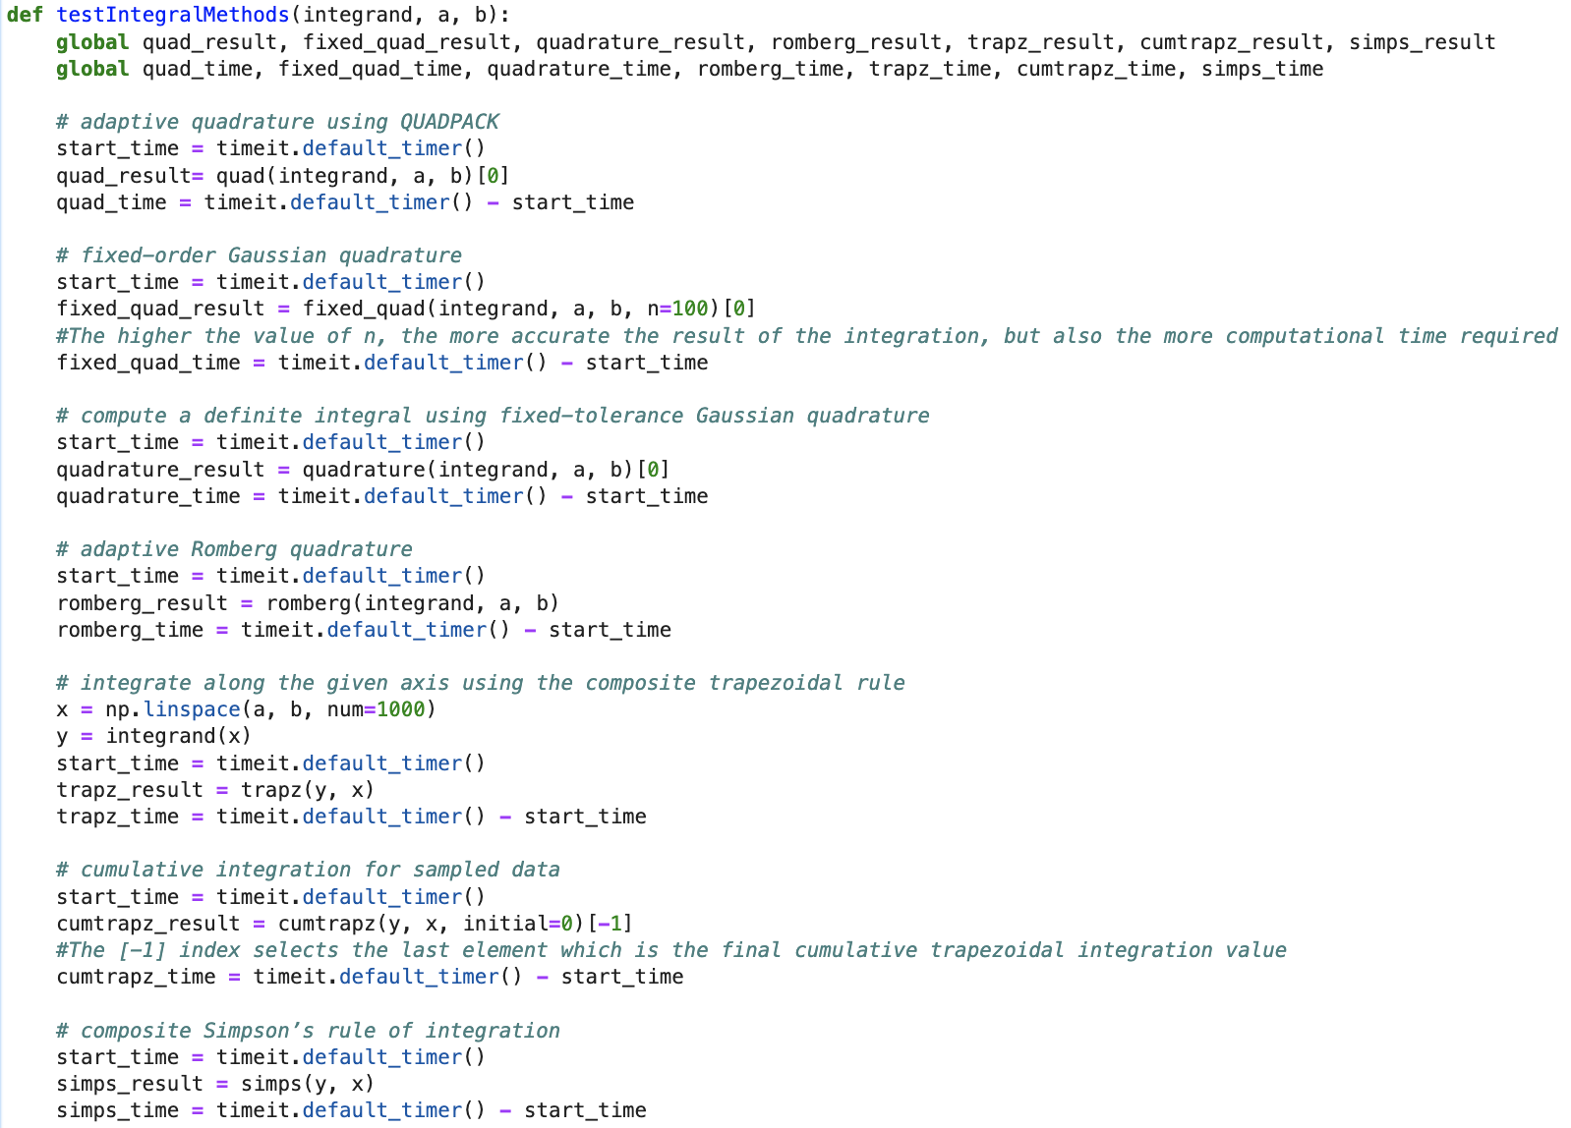

Slide 5












Integrands

Slide 6
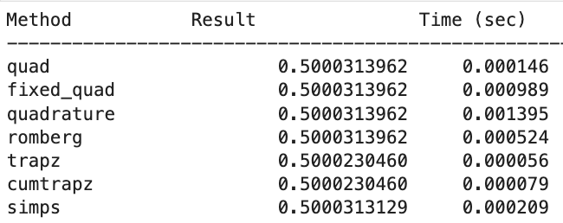
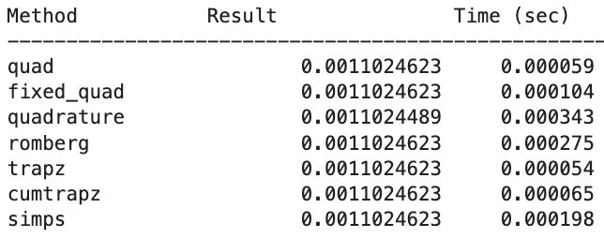
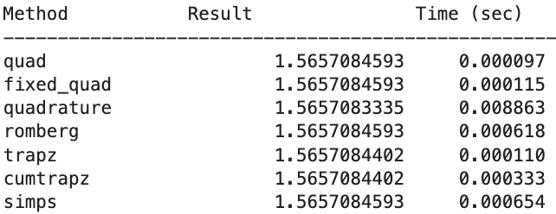
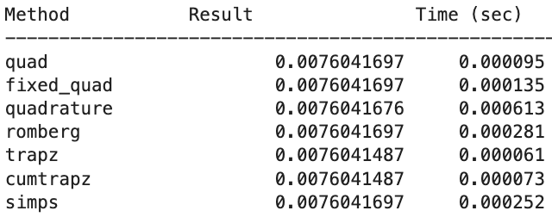
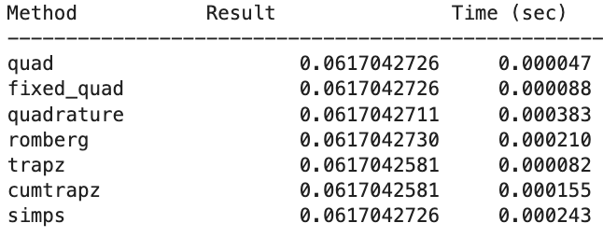
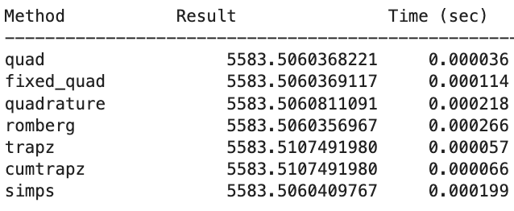
Trapz vs Cumtrapz Computation Time

Slide 7
Quad’s Computation Time

Slide 8
Quadrature’s Slow Computation Time

Slide 9
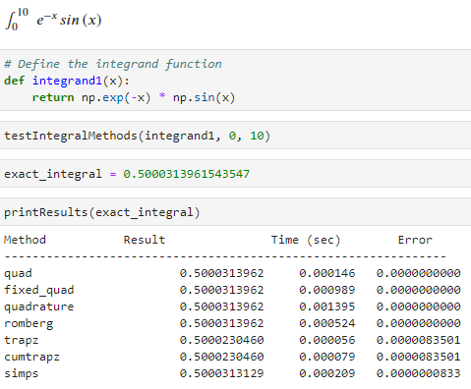

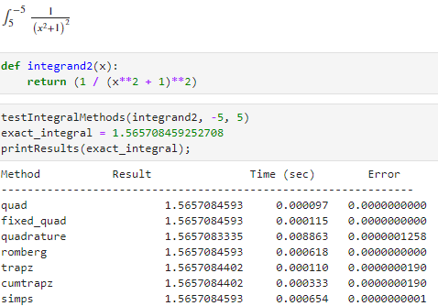

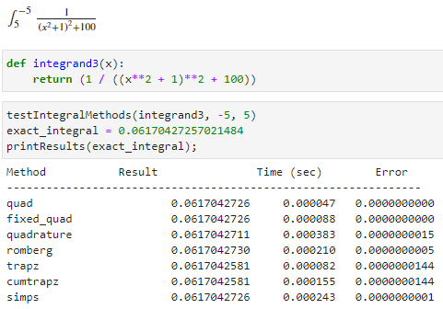
Accuracy

Slide 10
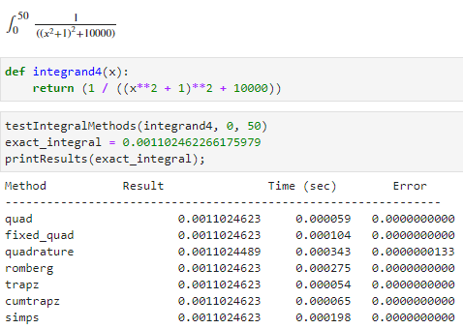
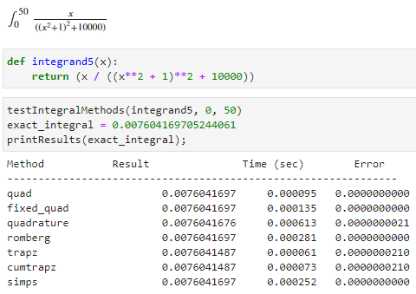
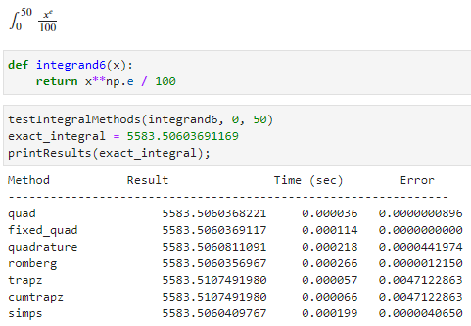
Accuracy

Slide 11
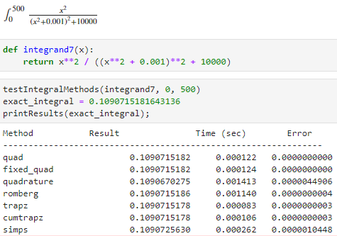
Small Offset

Slide 12
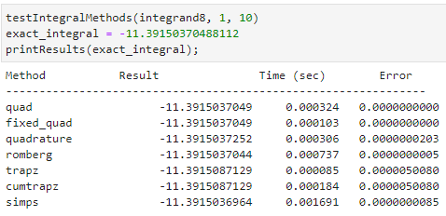

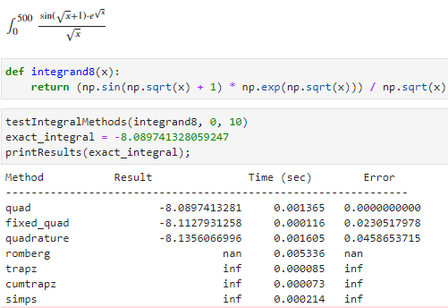
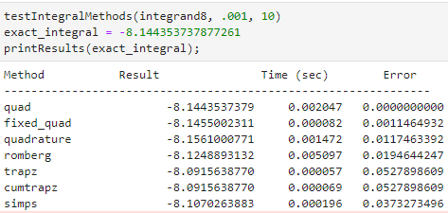
Non-Quad Methods Break

Slide 13
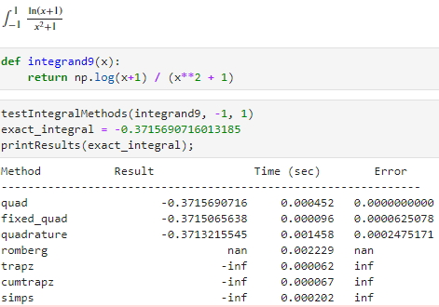
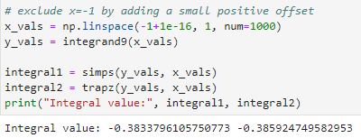
Non-Quad Methods Break

Slide 14
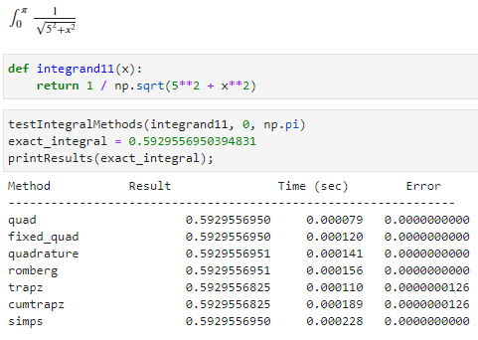
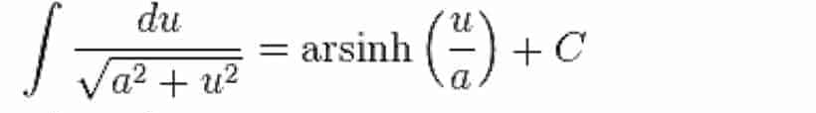
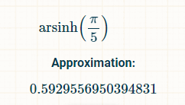
Testing Identities

Slide 15

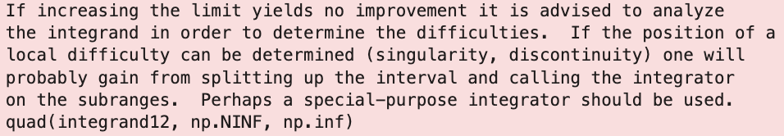
Infinite Limits

Slide 16
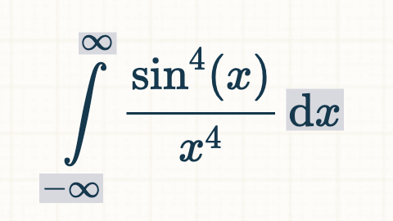
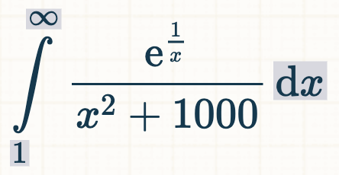
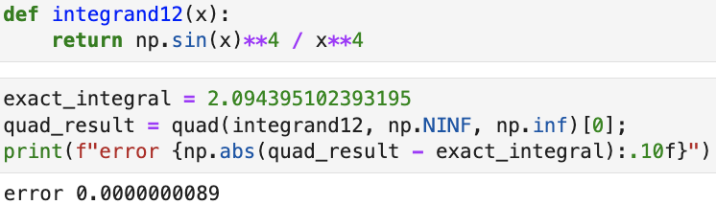
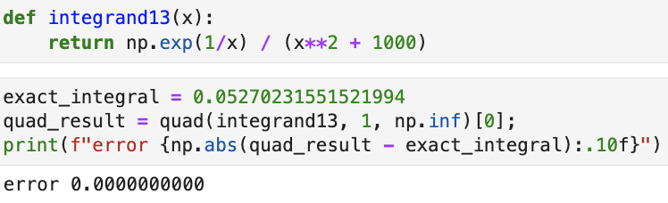
Infinite Limits With Quad

Slide 17
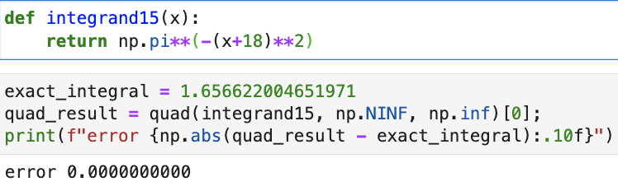
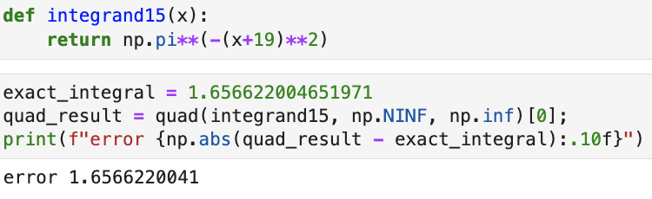
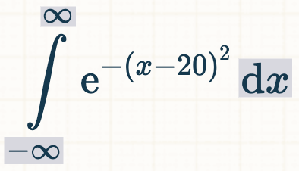
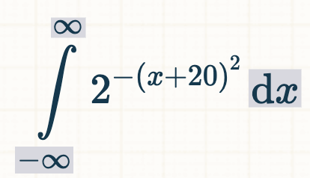
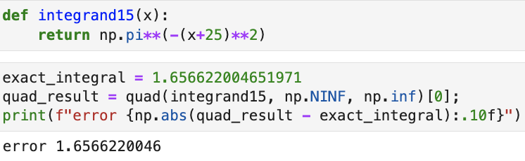
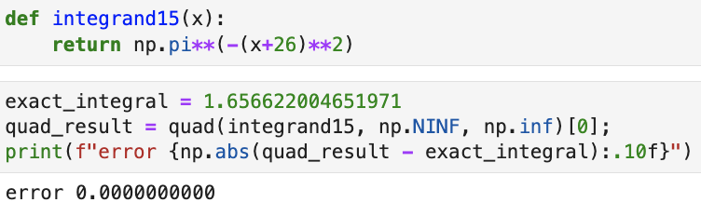
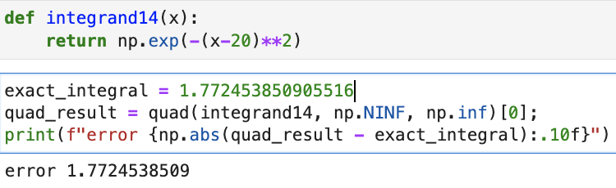
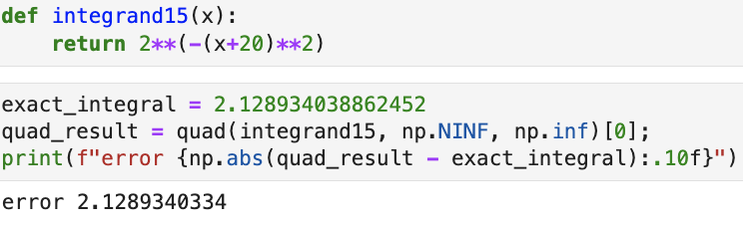
Quad’s Major Weakness

Slide 18

Results and Interpretation
Best Efficiency: Quad
Best Accuracy: Quad
Worst Efficiency: Quadrature
Worst Accuracy: Trapz, Cumtrapz, Quadrature
Each method has its pros and cons, but overall Quad is the best option for nearly every integrand you throw at it!

Slide 19

Sources
https://docs.scipy.org/doc/scipy/tutorial/integrate.html
https://www.tutorialspoint.com/scipy/scipy_integrate.htm
https://www.geeksforgeeks.org/scipy-integration/
https://www.integral-calculator.com/
https://www.symbolab.com/
https://medium.com/@mathcube7/what-they-dont-tell-you-about-numerical-integration-4a95de9f4e86
https://www.johndcook.com/blog/2012/03/20/scipy-integration/

